Slide 1

Reinforcement Learning-based Frequency Control for Renewable Energy Microgrids

Slide 2
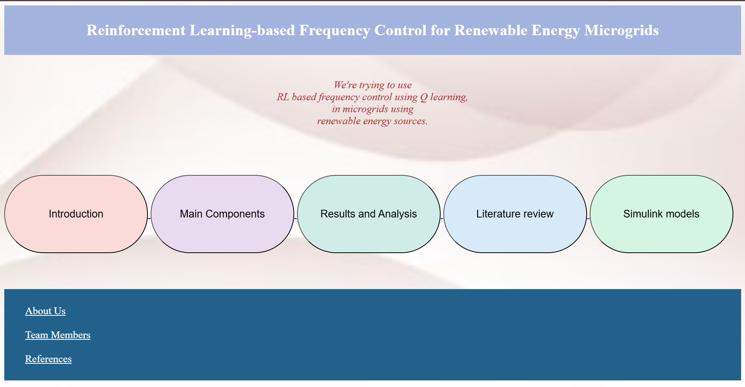
INTRODUCTION PAGE

Slide 3
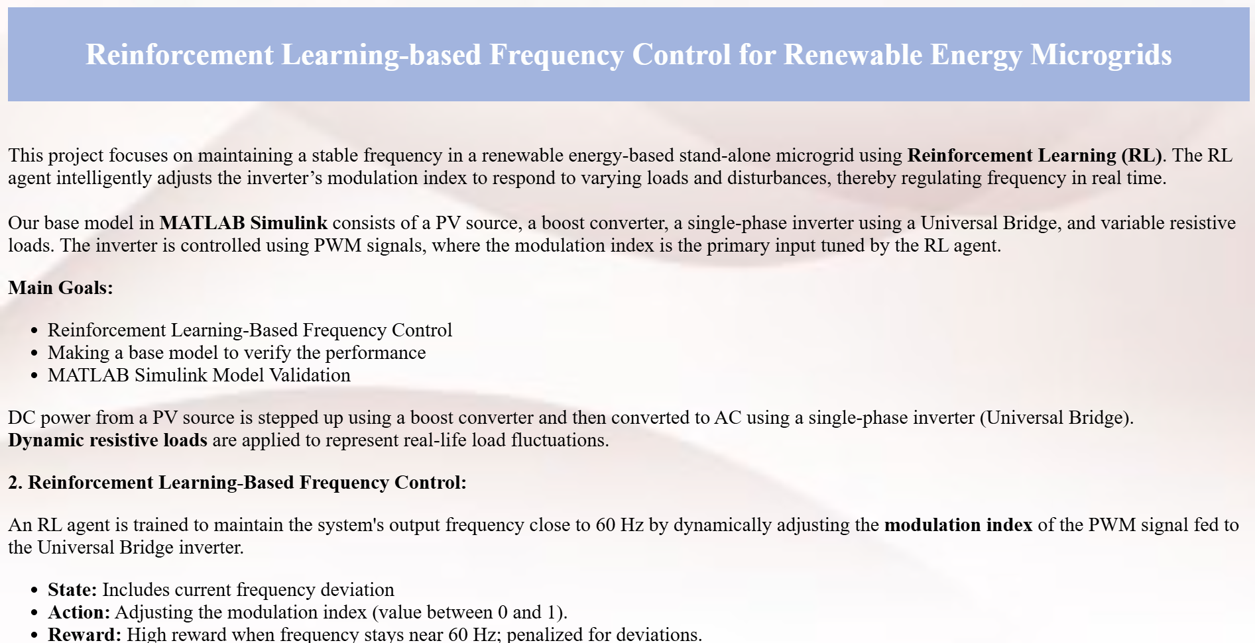
OUR AIM PAGE

Slide 4
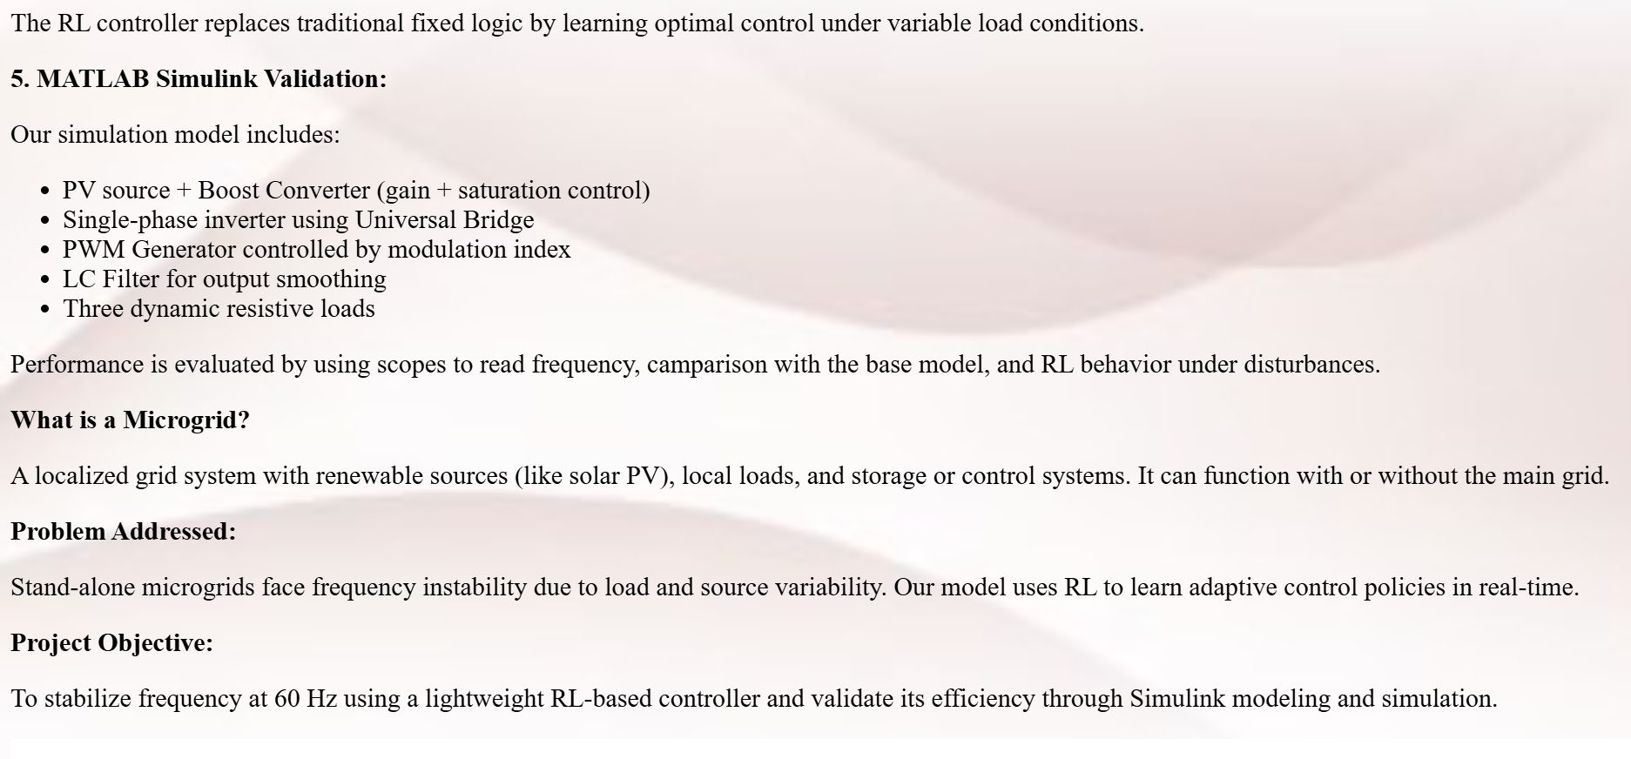
OUR AIM PAGE

Slide 5
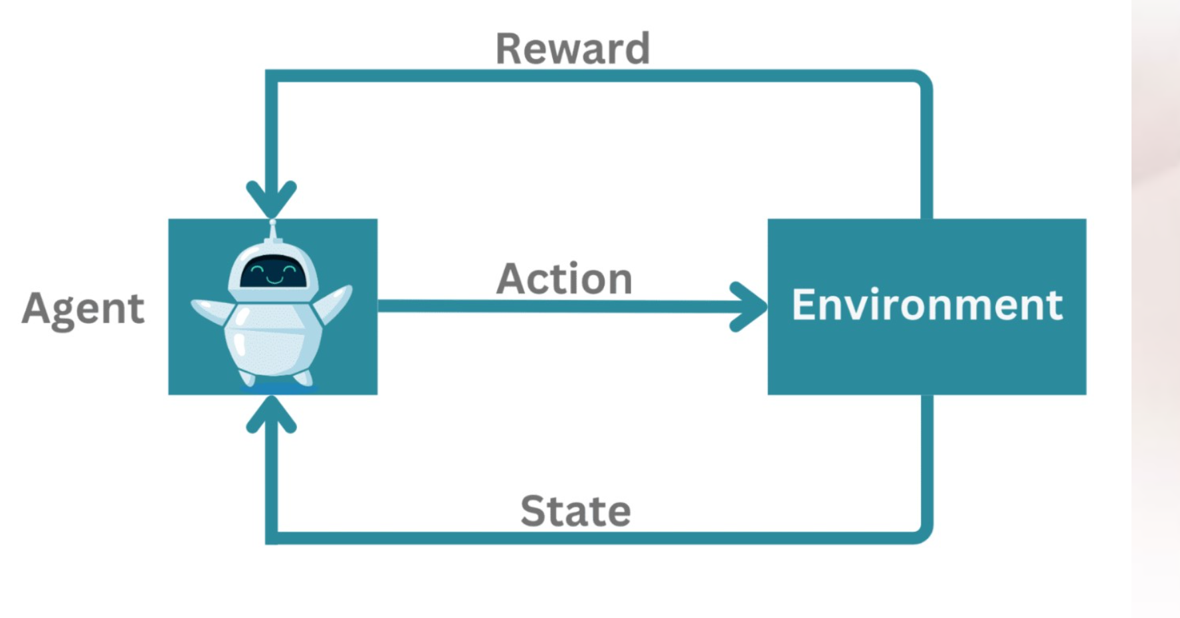
OUR AIM PAGE

Slide 6
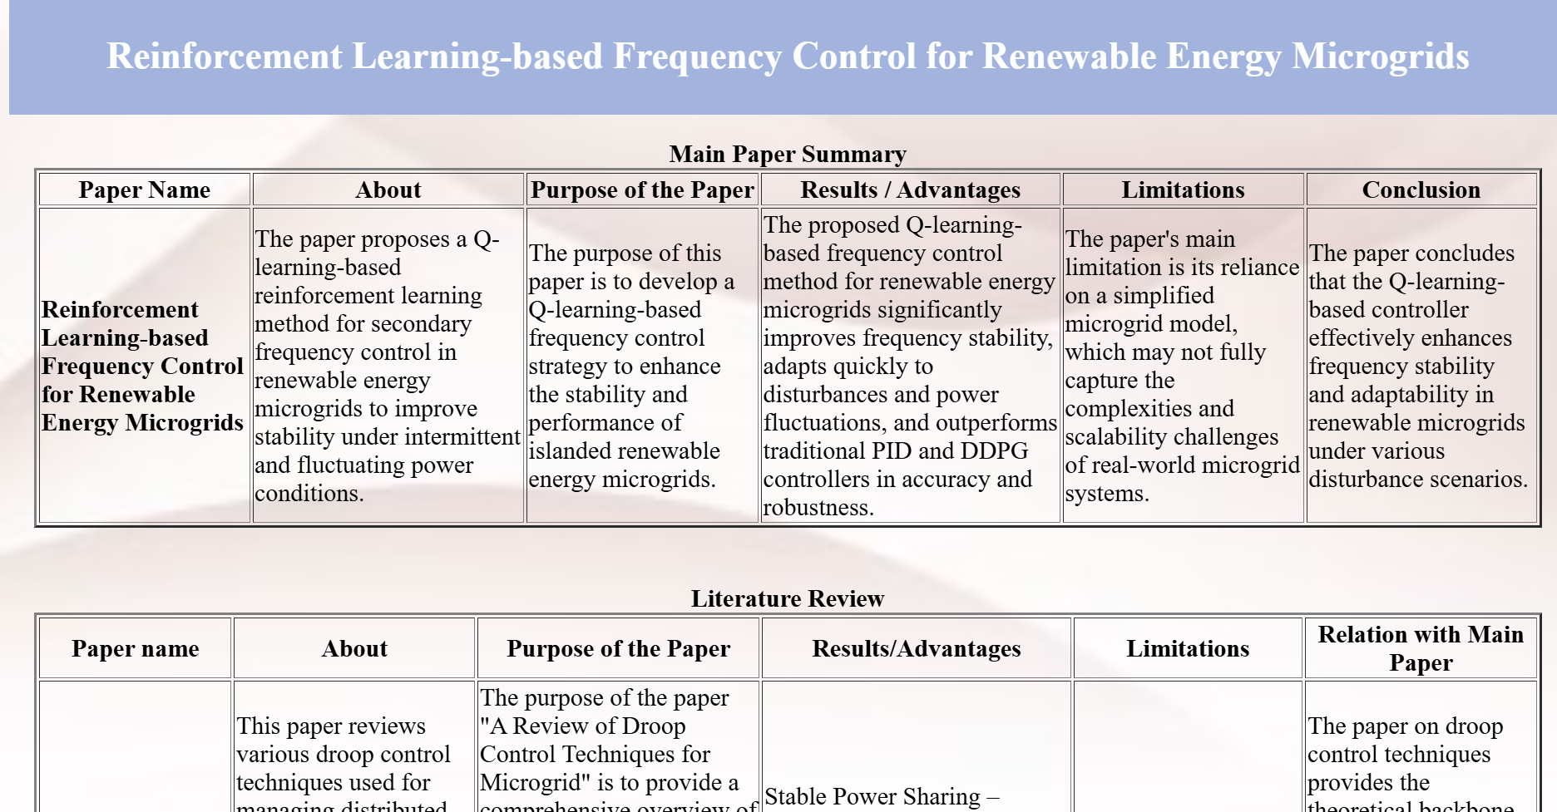
LITERATURE REVIEW

Slide 7
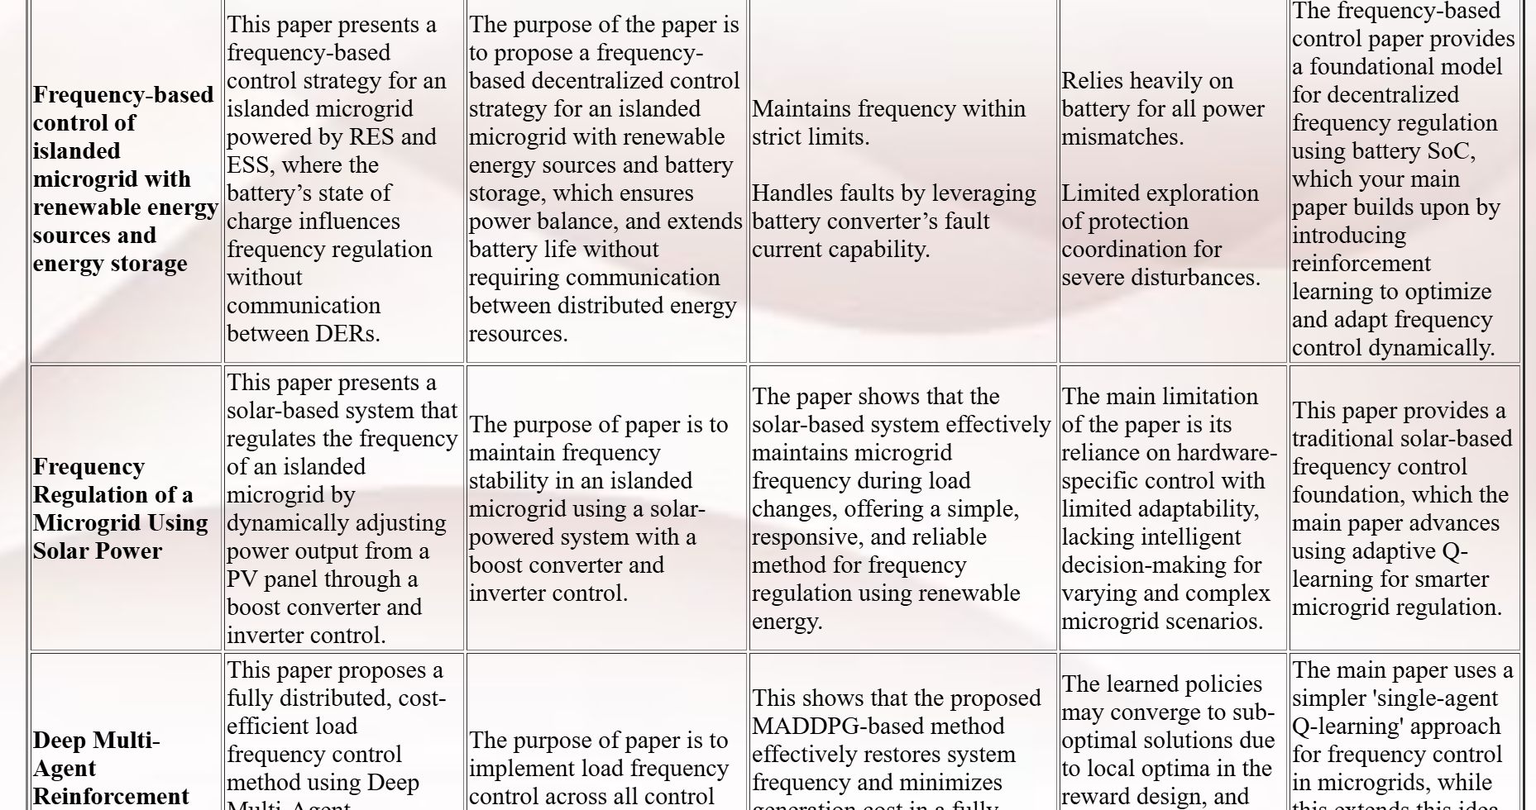
LITERATURE REVIEW

Slide 8
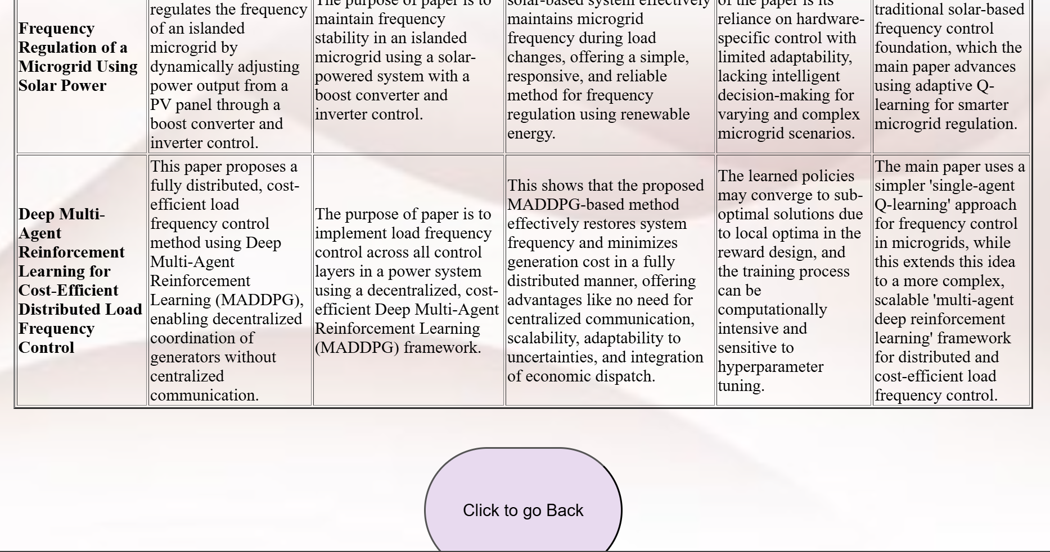
LITERATURE REVIEW

Slide 9
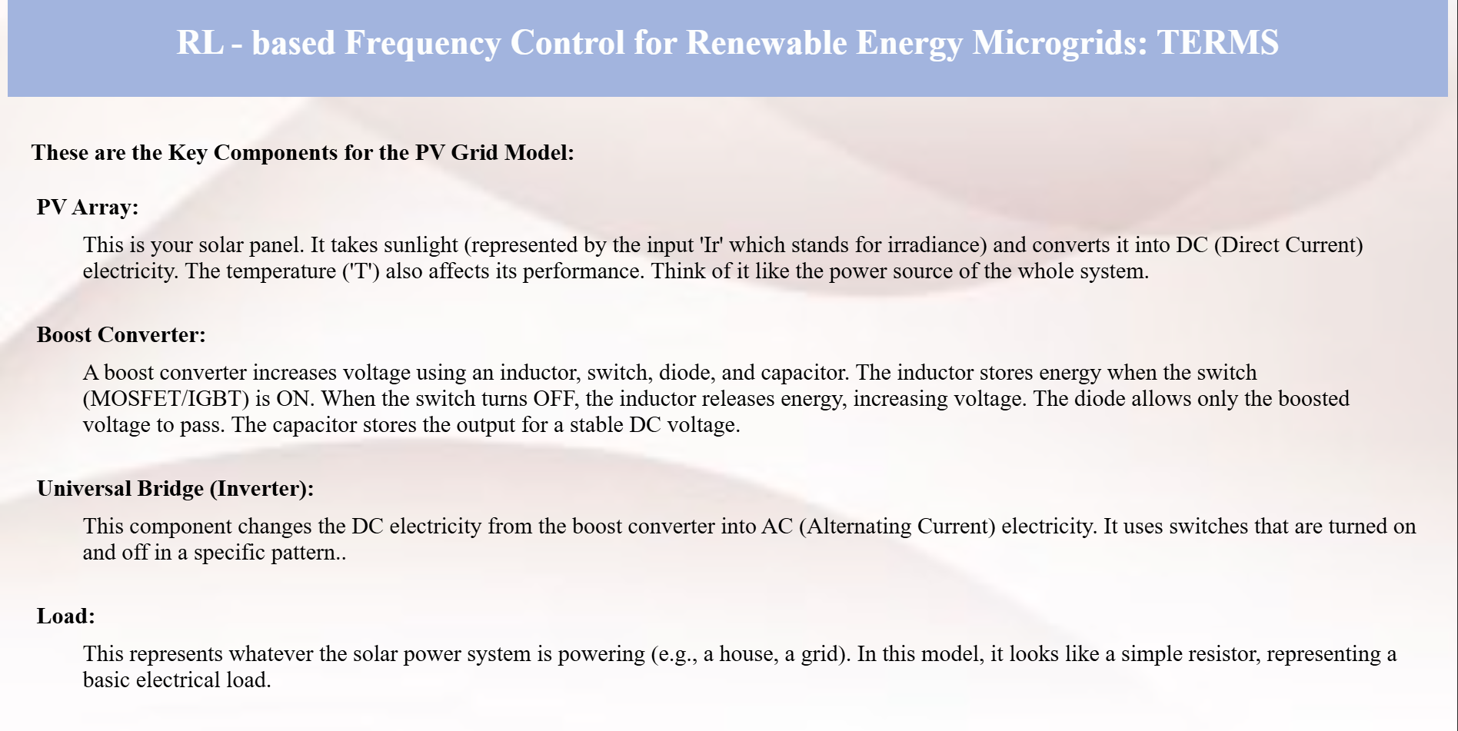
MAIN COMPONENTS

Slide 10
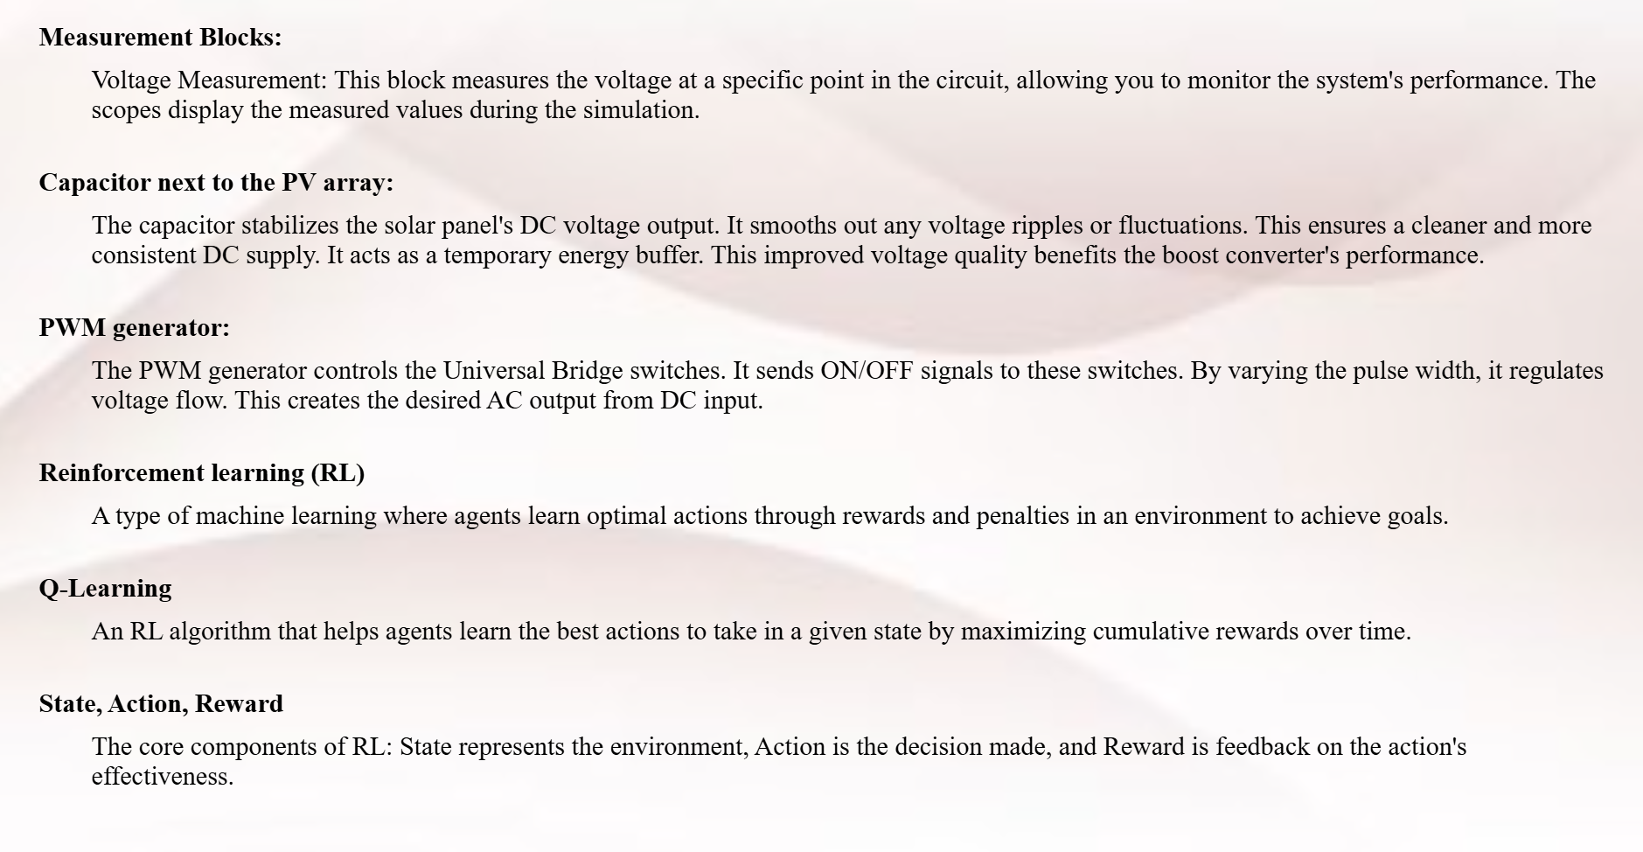
MAIN COMPONENTS

Slide 11
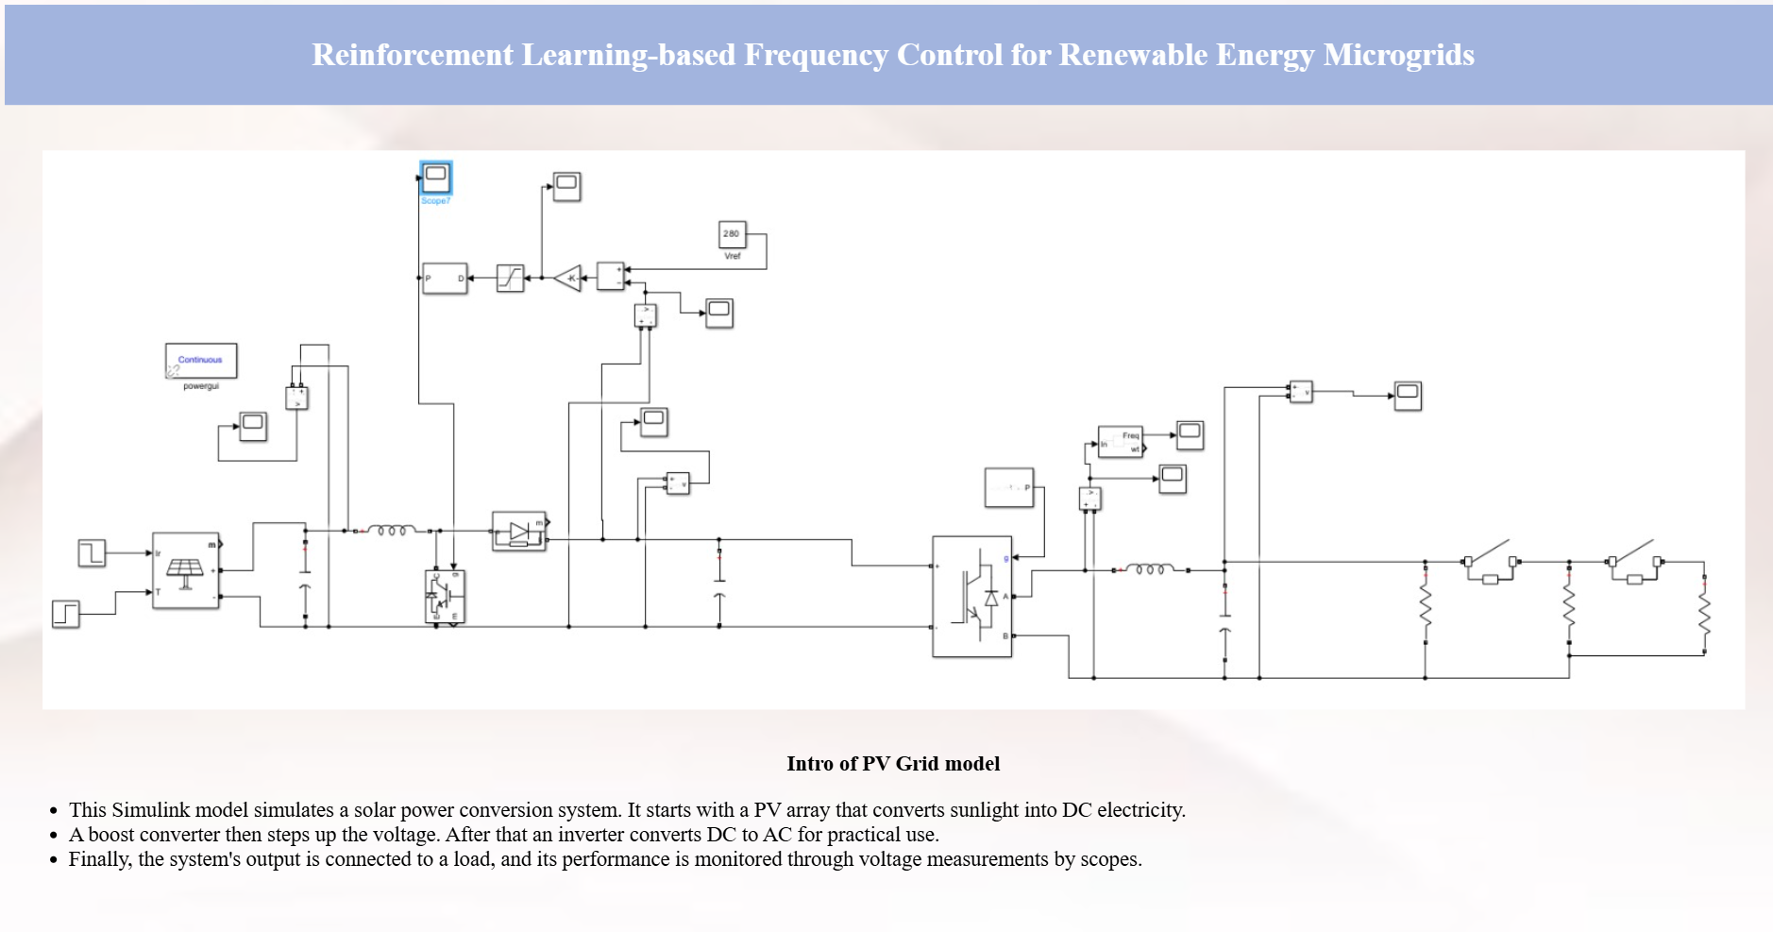
SIMULINK MODELS

Slide 12
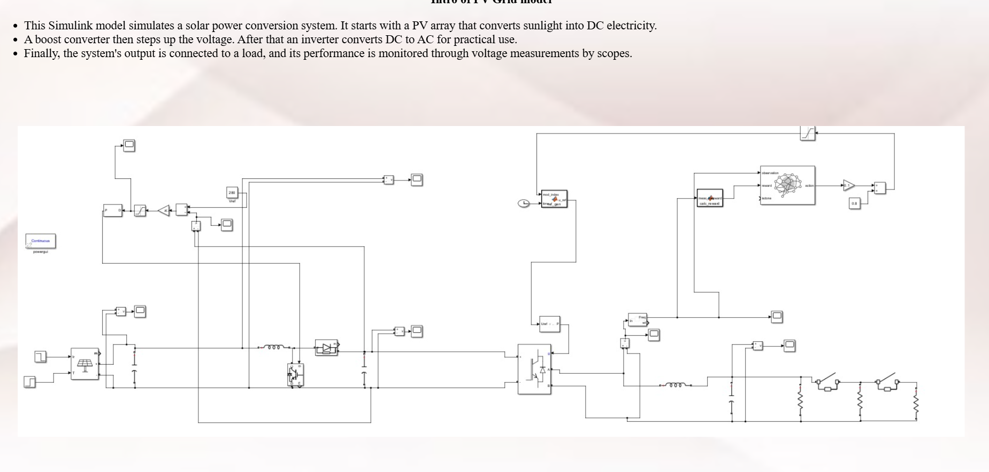
SIMULINK MODELS

Slide 13
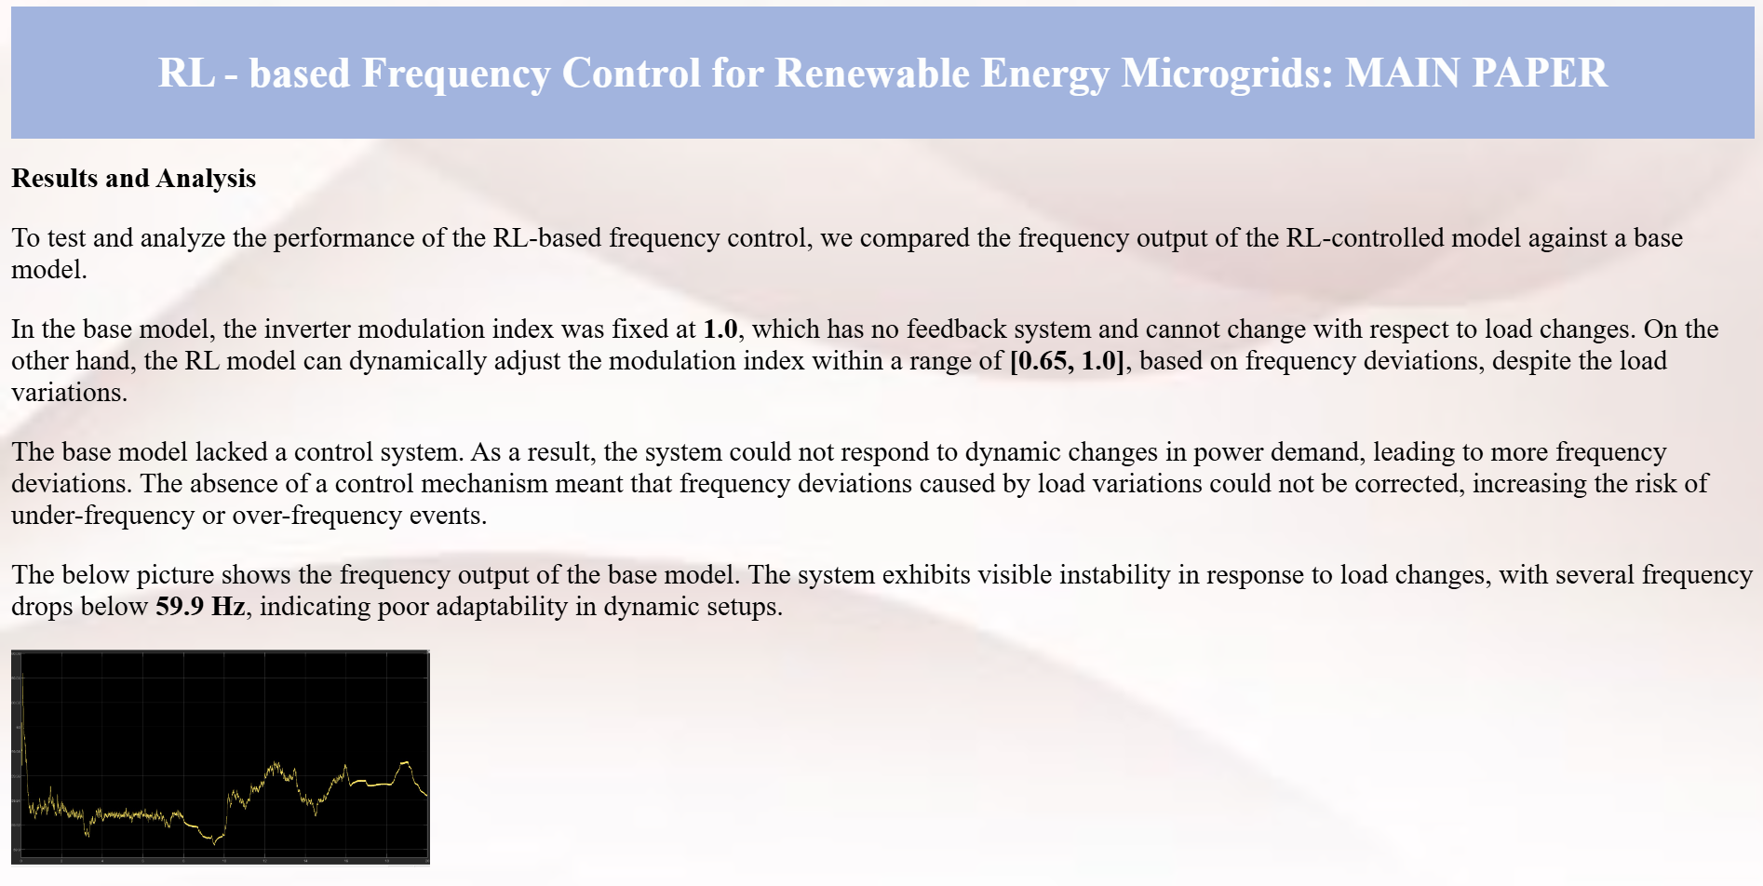
RESULTS AND ANALYSIS

Slide 14
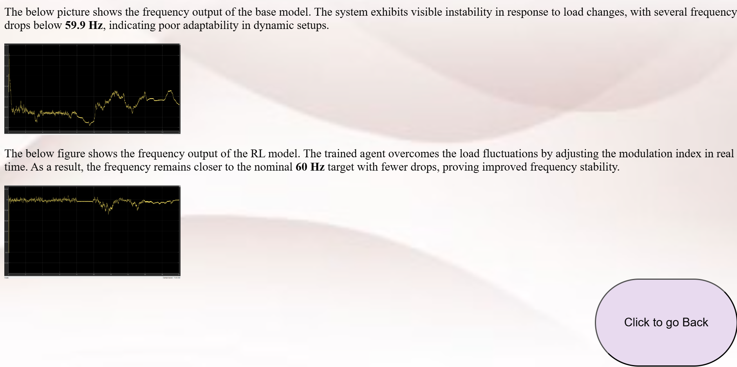
RESULTS AND ANALYSIS

Slide 15
Team Members
K V Meghana cb.sc.u4aie24022
K Supriya cb.sc.u4aie24025
K Siva Kumar cb.sc.u4aie24027
M Mahendra cb.sc.u4aie24032
THANK YOU !
We are Group 6..

